Slide 1
Pollution
Team members: C. Geetha Sravanthi B.Keerthi B.Sravanthi B. Mamatha C. Anusha

Slide 2

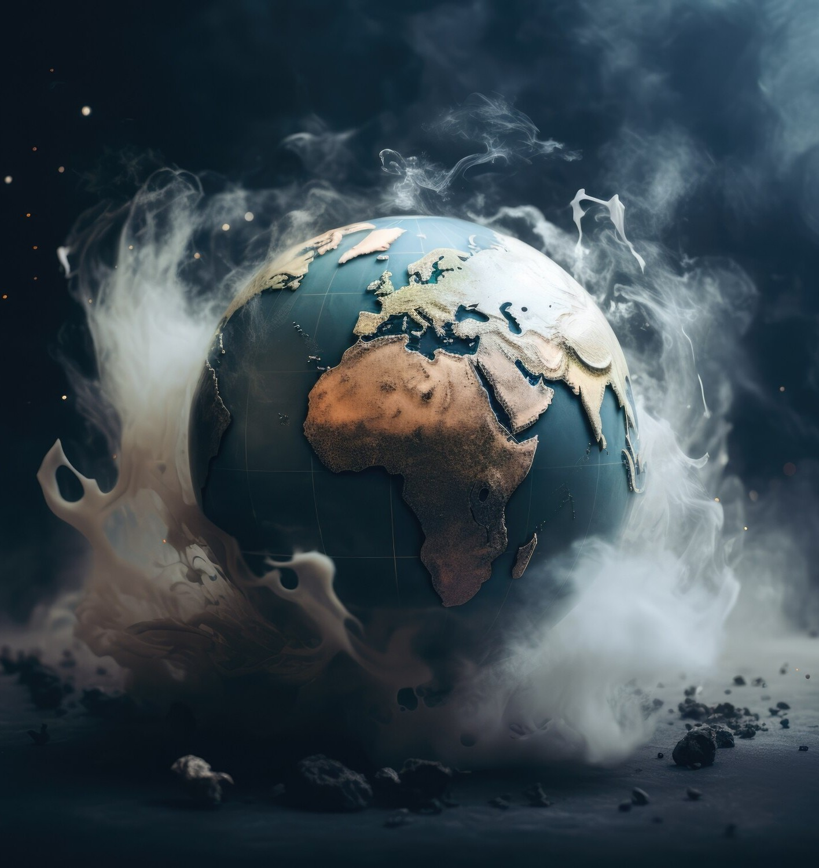
Introduction to Pollution
Pollution is the introduction of harmful materials into the environment. These harmful materials are called pollutants. Pollutants can be natural, such as volcanic ash. They can also be created by human activity, such as trash or runoff produced by factories.

Slide 3

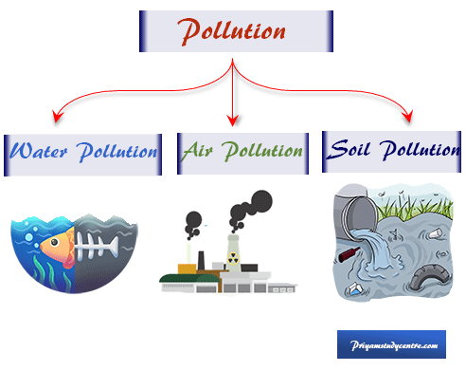
Types of Pollution:
Air pollution.
Water pollution.
Soil pollution.
Radioactive pollution.
Noise pollution

Slide 4
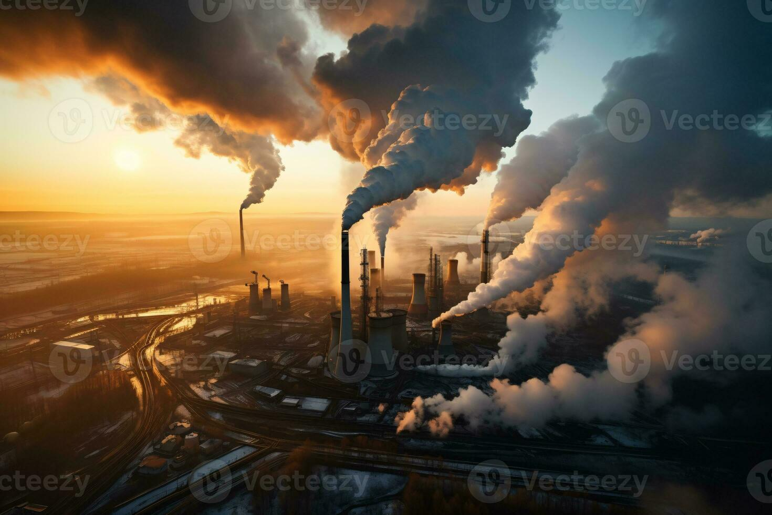
Air Pollution
Air pollution occurs when harmful gasses and dust are released into the atmosphere. There are many sources of air pollution, such as forest fires, human activities, and volcanic eruptions. Automobiles and power plants are the highest contributors. Air pollution causes diseases in humans and animals.

Slide 5

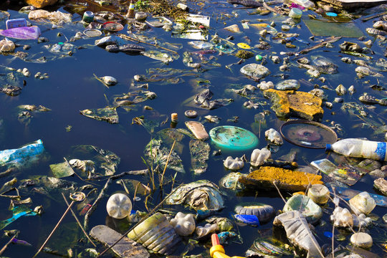
Water Pollution
Water pollution is any contamination of water with chemicals or other hazardous substances that are detrimental to human, animal, or plant health. Possible sources of water contamination are: Corroded water pipes that leach harmful chemicals, such as lead. Hazardous waste sites and industrial discharges.

Slide 6

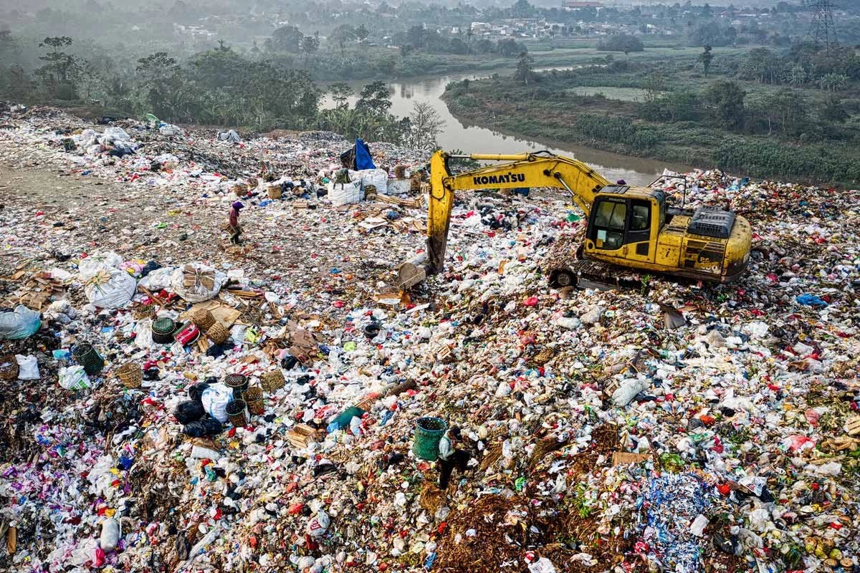
Soil Pollution
Soil pollution refers to the contamination of soil with anomalous concentrations of toxic substances. It is a serious environmental concern since it harbours many health hazards. For example, exposure to soil containing high concentrations of benzene increases the risk of contracting leukemia.
.

Slide 7
Causes Of Pollution:
Construction
Open burning of garbage waste
Volcanic eruptions
Exhaust gases from industries and factories
Transportation
Oil spills
Fertilizers and pesticides
Radioactive waste

Slide 8
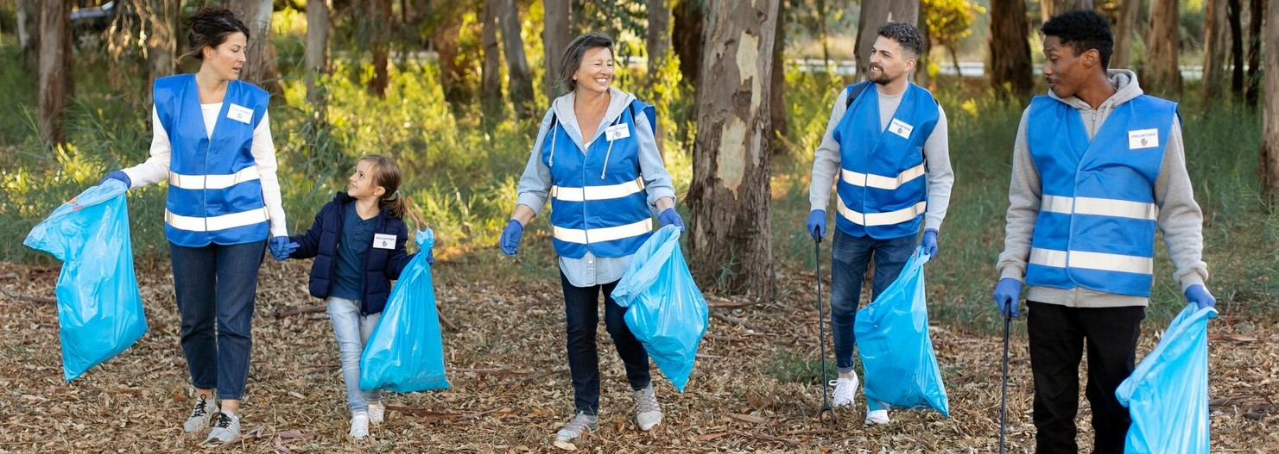
How to prevent pollution?
Pollution Prevention
Alternatives in Transportation
Waste Reduction
Rain Barrel Collection
Yard and Garden Care
Plant and care for trees

Slide 9

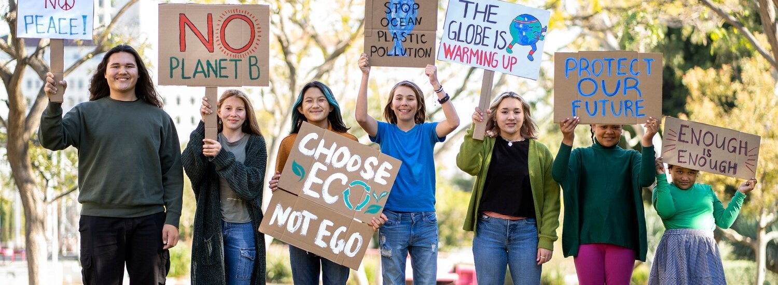
Conclusion: Call to Action
In Conclusion, Pollution is a complex challenge that requires immediate
Attention. By understanding and taking protective steps, we can work
towards a sustainable future. Let’s commit to being guardians of our
Environment.

Slide 10

Thank You!

